Slide 1
Advanced Angular
Directives
Lecture 4
By James(Jin) Wang
10/05/2019

Slide 2
Outline
ngFor
ngIf
ngSwitchCase
ngClass
ngStyle
Building custom directives

Slide 3
ngIf
  Directives:

Slide 4
ngIf
  Before:
  add:
  <div *ngIf="courses.length > 0">
  List of Courses
  </div>
  After:
  add:
  <div *ngIf="courses.length > 0">
  List of Courses
  </div>

Slide 5
Pass data
  Input Properties:
  add: <app-favorite [isFav]="post.isFav"></app-favorite>

Slide 6
Pass data
  Aliasing Input Properties:
  add: @Input('is-fav') isFav: boolean;

Slide 7
Pass data
  Output Properties:
  add: @Output() change = new EventEmitter();
  add:
  toggleFav() {
  this.isFav = !this.isFav;
  this.change.emit();
  }

Slide 8
Raise custom Events
  Passing Event Data:
  add:
  onFavChanged(isFav) {
  console.log("Fav Changed! " + isFav);
  }
  add:
  toggleFav() {
  this.isFav = !this.isFav;
  this.change.emit(this.isFav);
  }

Slide 9
Raise custom Events
  Passing Event Data using Interface:
  add:
  export interface FavChangedEventArgs {
  newVal: boolean
  }
  add:
  toggleFav() {
  this.isFav = !this.isFav;
  // this.change.emit(this.isFav);
  this.change.emit({newVal: this.isFav});
  }

Slide 10
Raise custom Events
  Aliasing Output Properties:
  add:
  @Output('on-change') change = new EventEmitter();

Slide 11
Apply styles
  Styles:
  add:
  styles: [
  `
  .glyphicon {
  font-size: 60px;
  }
  `
  ]

Slide 12
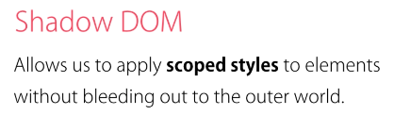
View Encapsulation
  View Encapsulation:
  Shadow DOM:

Slide 13
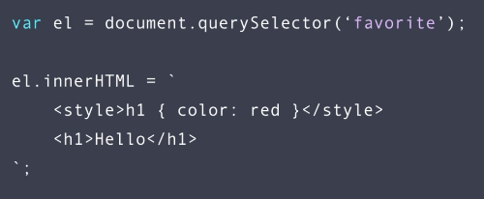
View Encapsulation
  Shadow DOM example:

Slide 14
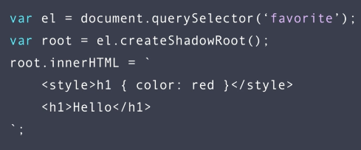
View Encapsulation
  Shadow DOM solution:
  add:
  encapsulation: ViewEncapsulation.Emulated

Slide 15
View Encapsulation
  ngContent:
  ng g c panel
  add:
  <app-panel>
  <div class="heading">
  Heading
  </div>
  <div class="body">
  <h2>Body</h2>
  <p>boody contents .....</p>
  </div>
  </app-panel>

Slide 16
View Encapsulation
  ngContainer:
  add:
  <app-panel>
  <ng-container class="heading">
  Heading
  </ng-container>
  <ng-container class="body">
  <h2>Body</h2>
  <p>boody contents .....</p>
  </ng-container>
  </app-panel>

Slide 17
Summary

